Slide 1
Interrupts of 8085 microprocessor
Presented by:
Dr. Sk Babar Ali
Associate Professor
ECE department, Aliah University

Slide 2
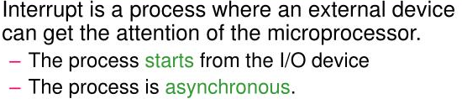
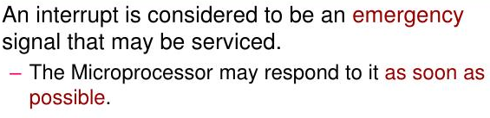
Interrupts
Main program
Interrupt
Interrupt
ISR

Slide 3
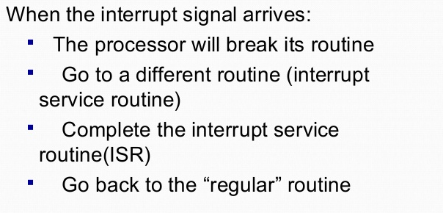
Main program
Interrupt
Interrupt
ISR

Slide 4
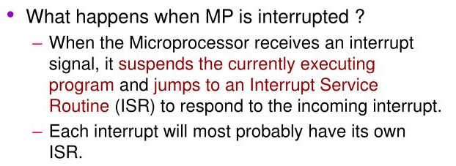
After completing the interrupt service routine again back to the main program from where it is left.

Slide 5
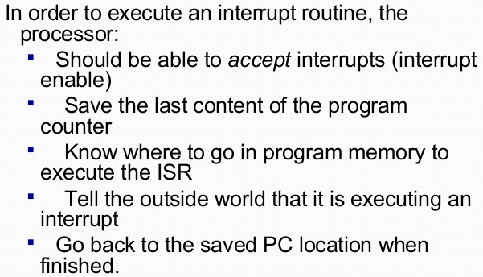

Slide 6
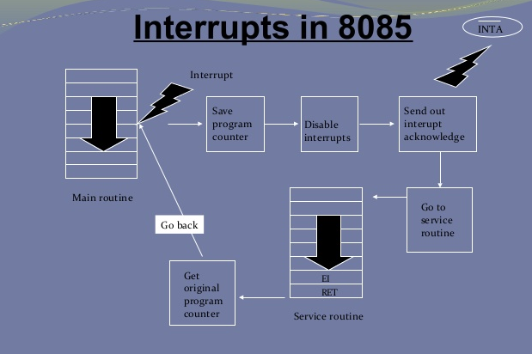

Slide 7
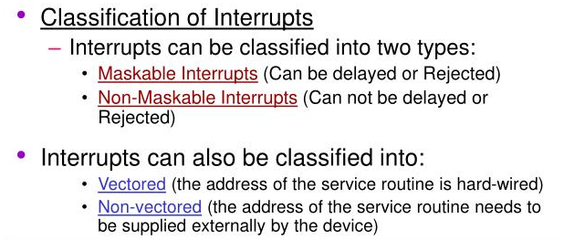
Hardware interrupts (can be enable by hardware circuit)
Software interrupts ( can be enable by software instruction)

Slide 8
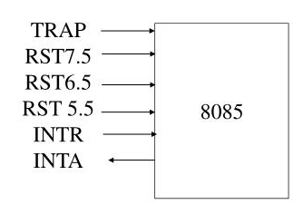
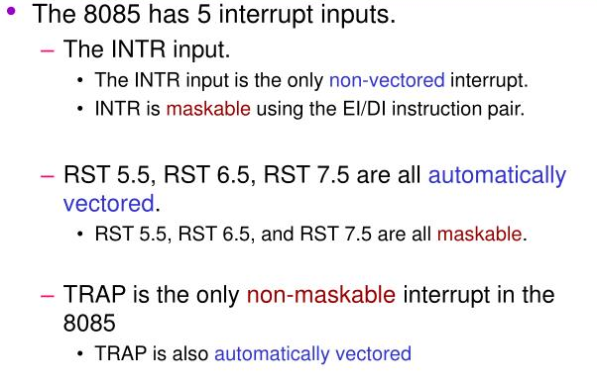
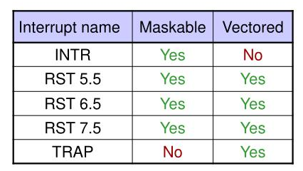

Slide 9
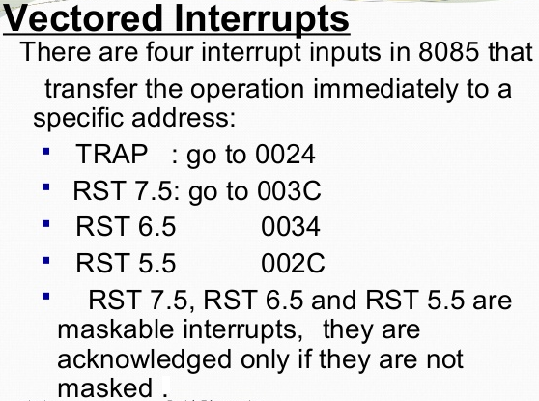

Slide 10
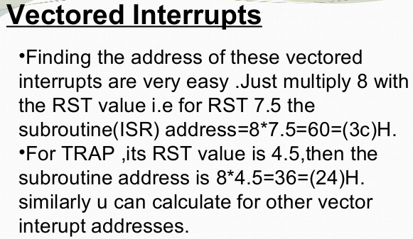

Slide 11
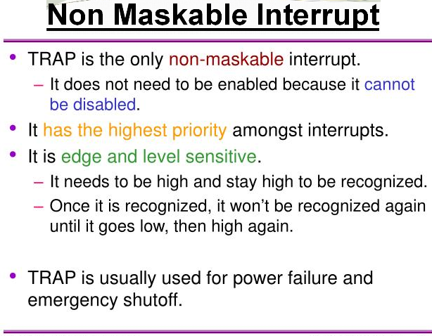

Slide 12

Interrupts | Type | Vector Location | Enable (Trigger)
TRAP | NON MASKABLE | 0024H | EADGE & LEVEL
RST7.5 | MASKABLE | 003CH | EADGE
RST6.5 | MASKABLE | 0034H | LEVEL
RST5.5 | MASKABLE | 002CH | LEVEL
INTR | NON VECTOR | XXXX | LEVEL………
RST0 | VECTOR | 0000H | INSTRUCTION
RST1 | VECTOR | 0008H | INSTRUCTION
RST2 | VECTOR | 0010H | INSTRUCTION
RST3 | VECTOR | 0018H | INSTRUCTION
RST4 | VECTOR | 0020H | INSTRUCTION
RST5 | VECTOR | 0028H | INSTRUCTION
RST6 | VECTOR | 0030H | INSTRUCTION
RST7 | VECTOR | 0038H | INSTRUCTION

Slide 13
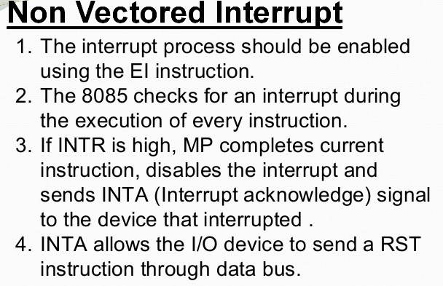

Slide 14
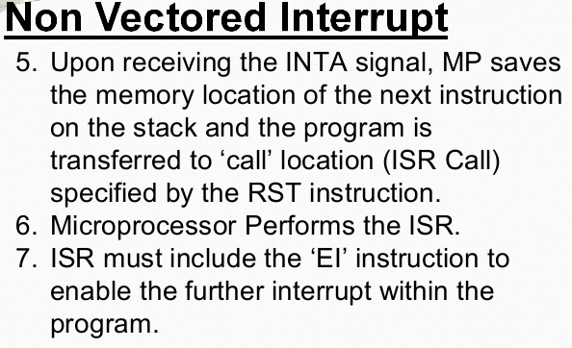

Slide 15
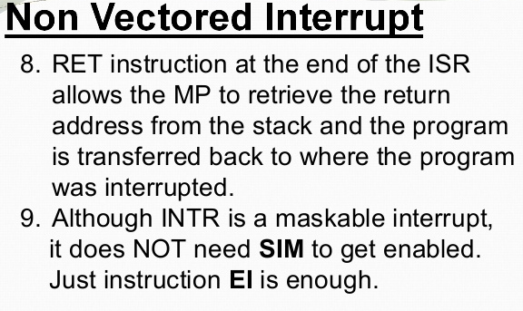

Slide 16
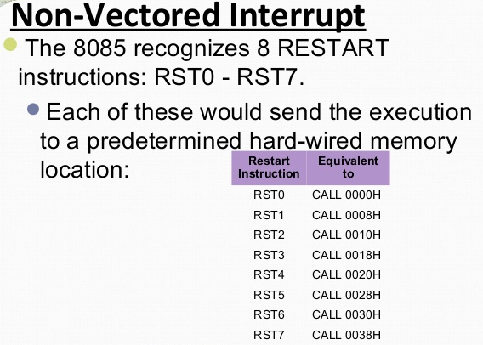
Interrupts | Opcode | Vector Location
INTR | xxxx | XXXX
RST0 | C7 | 0000H
RST1 | CF | 0008H
RST2 | D7 | 0010H
RST3 | DF | 0018H
RST4 | E7 | 0020H
RST5 | EF | 2080H
RST6 | F7 | 0030H
RST7 | FF | 0038H

Slide 17
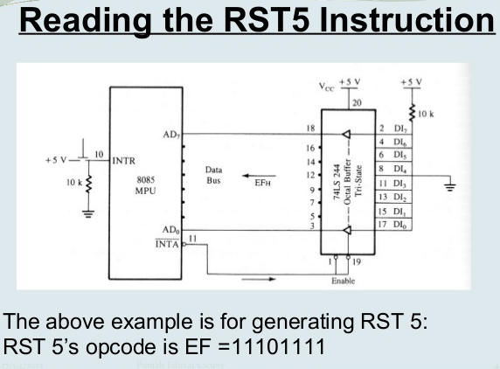

Slide 18
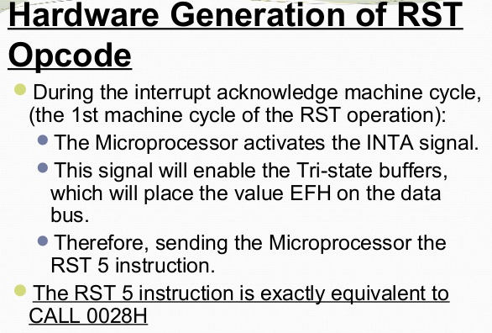

Slide 19
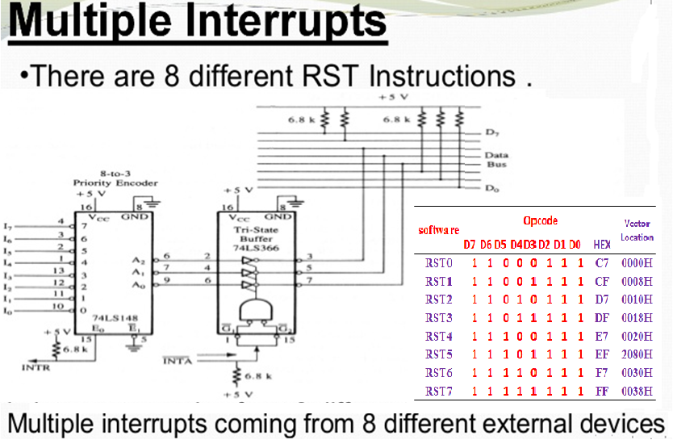

Slide 20
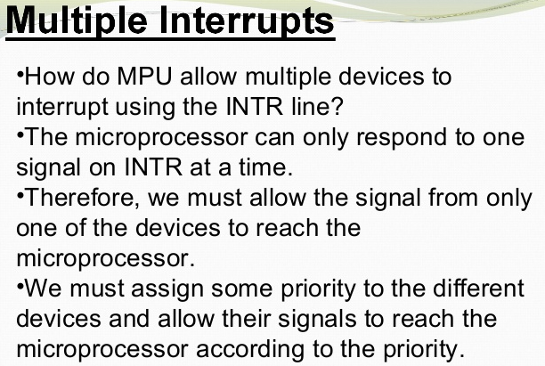

Slide 21
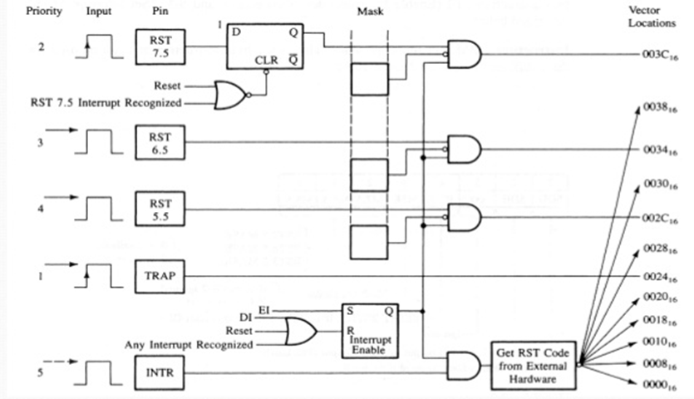
INTERRUPTS CIRCUIT

Slide 22
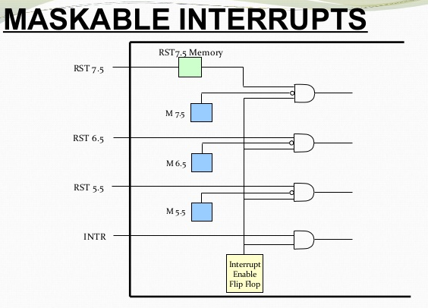

Slide 23
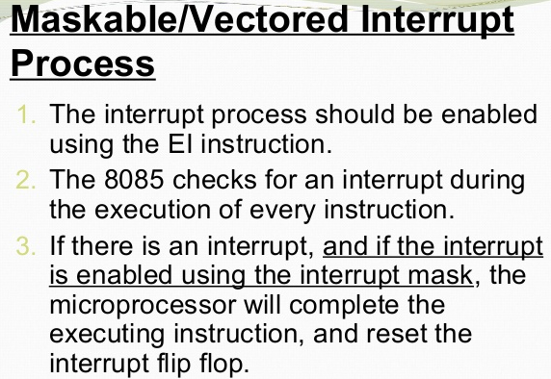
/8 Step Process

Slide 24
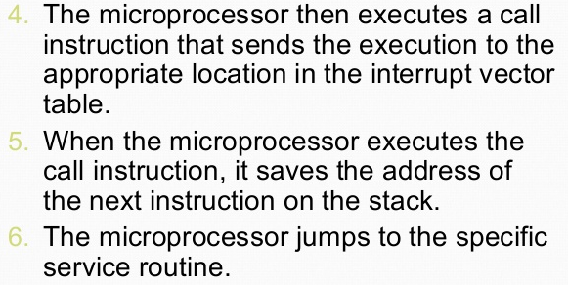
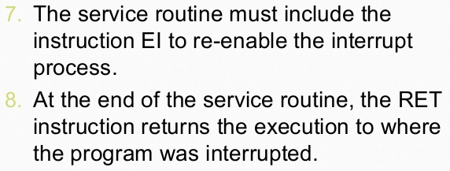

Slide 25

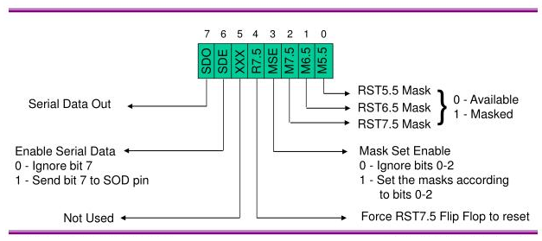
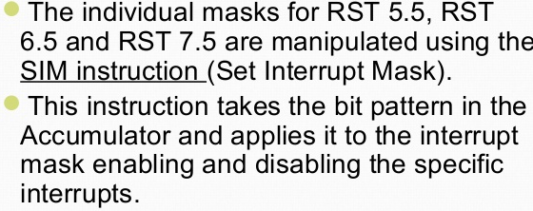

Slide 26
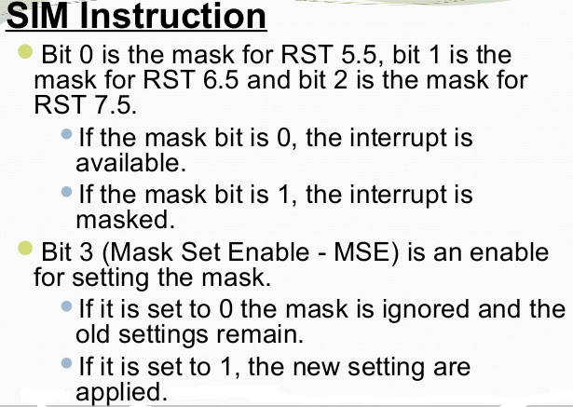

Slide 27
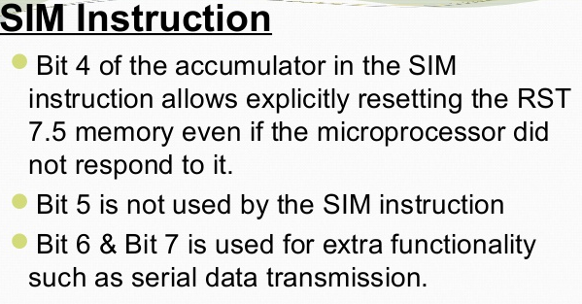

Slide 28
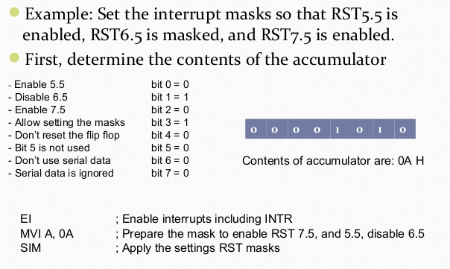
Problem:

Slide 29
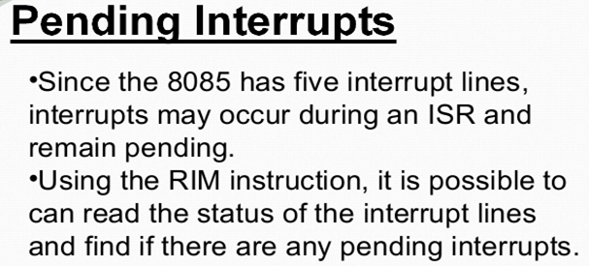

Slide 30
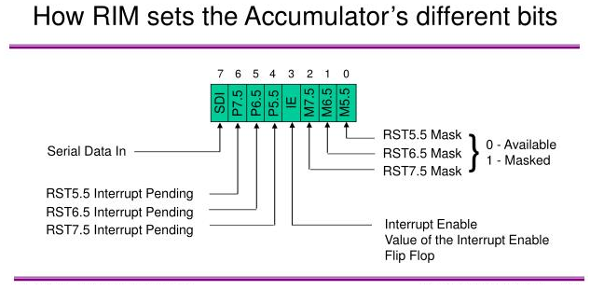

Slide 31
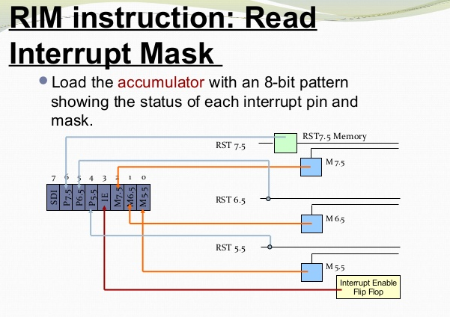

Slide 32
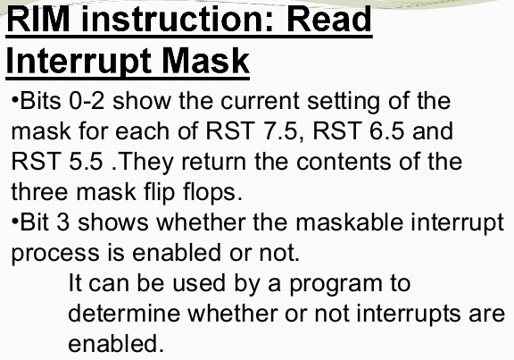

Slide 33
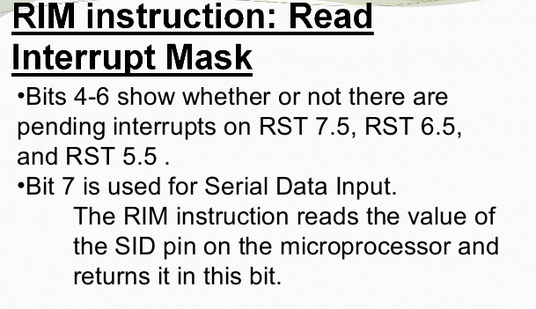

Slide 34
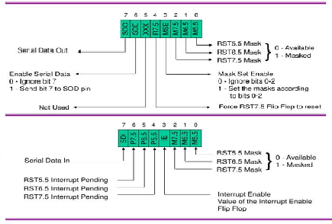
Problem:
Assuming the microprocessor is completing an RST 7.5 interrupt request. Check to see if RST 6.5 is pending. If it is pending, enable RST6.5 without affecting any other interrupts. Otherwise, return to the main program.
RIM | Read the interrupt mask
MOV B,A | Save mask information
ANI 20 | Check whether RST6.5 is pending
JNZ NEXT | If it is pending then jump to NEXT
EI | Enable interrupt F/F
RET | Return to main program
NEXT MOV A,B | Mask information move to accumulator
ANI 0D | Enable RST6.5 by setting D1=0
ORI 08 | Enable SIM by setting D=1
SIM | Enable SIM
SIM
RIM

Slide 35
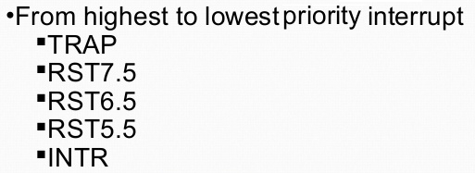

Slide 36
Any questions…….

